Slide 1
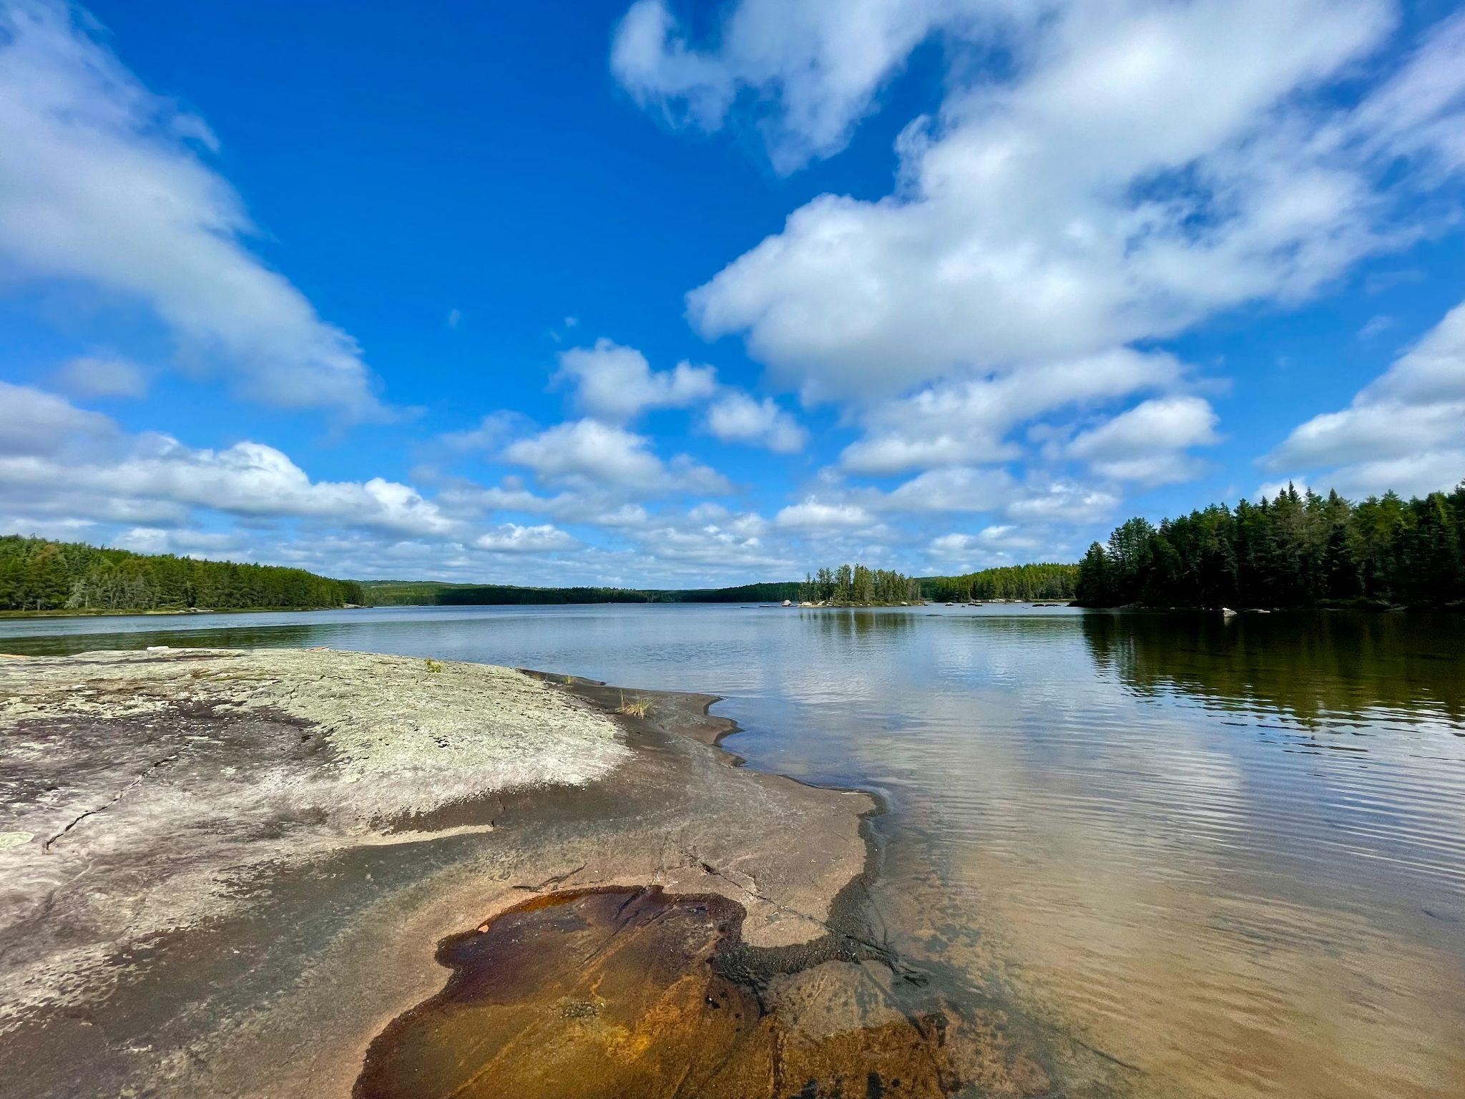
Effect of Freshwater Aquaculture on Epilimnetic Nitrogen, Phosphorus, and Chlorophyll A Levels
EEB313 - December 5, 2023
Elli Hung, Jaden Tran, Karen Sit, Kumal Udamulla

Slide 2
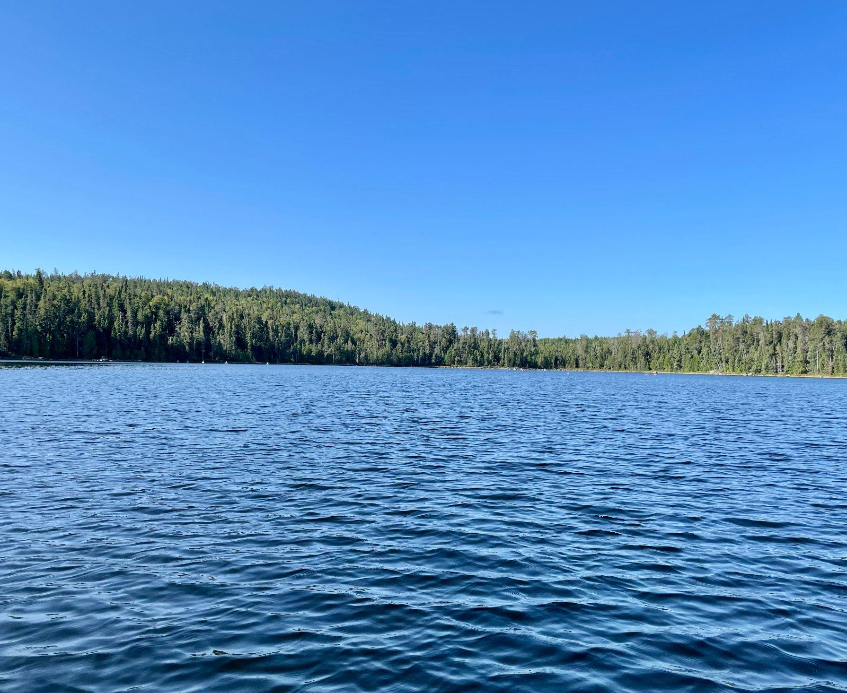
Why we should study aquaculture and why it matters
Aquaculture part of the solution towards global food security^{1,2}
Environmental impacts of freshwater aquaculture largely unknown³
Water quality degradation
Impacts on biota
Cumulative impacts of aquaculture on a whole aquatic system is difficult to study
Costello et al., 2020
Garlock et al., 2022
Yan, 2005
Notes:
Elli
· Aquaculture is a major industry around the world and many experts point towards its importance as we work towards global food security
· There are many concerns over the environmental impacts that could accompany freshwater aquaculture expansion revolving around water quality degradation and the impacts of these changes on biota inhabiting this environment
· Cage farms release large loads of organic matter and nutrients into the environment and the cumulative impacts of aquaculture on a whole aquatic ecosystem is difficult to study.

Slide 3
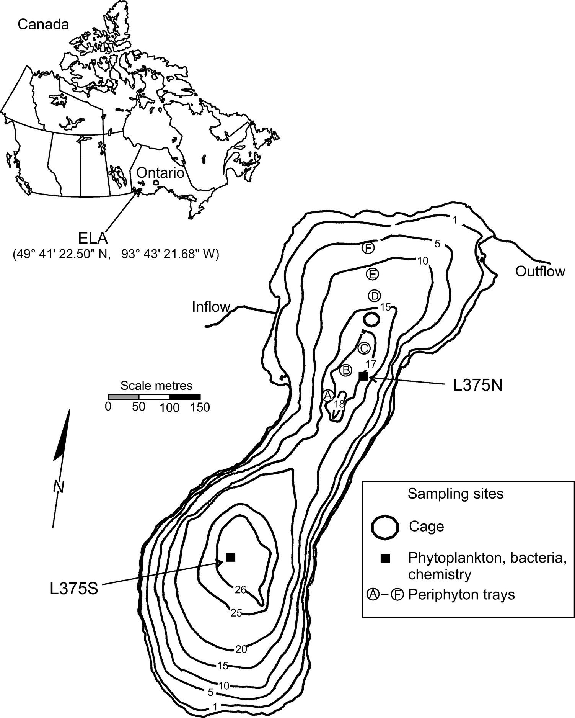
IISD-ELA Lake 375 - Aquaculture Experiment
Oligotrophic (max depth 26 m)
Dimictic (mixes twice a year)
Experimental period: 2003-2007
10,000 female rainbow trout raised annually 10x10m aquaculture cage
Measurements of water chemistry, fish health, other ecosystem impacts (e.g. zoop and native fish pops)
Findlay et al., 2009
Notes:
Elli
This field site isolated from the rest of society in Northwestern ON
Extensive data has been collected on these lakes since the site opened in the 1960s and they’re well known for their whole-lake manipulation experiments can be done without confounding factors such as human civilization nearby
L375 is oligotrophic (deep and cold) and dimictic (thermal stratification causes the water column to mix twice a year)
During 2003-2007, 10,000 rainbow trout were raised each season in an aquaculture cage
Measurements of water chemistry, fish health, and other ecosystem impacts were recorded

Slide 4
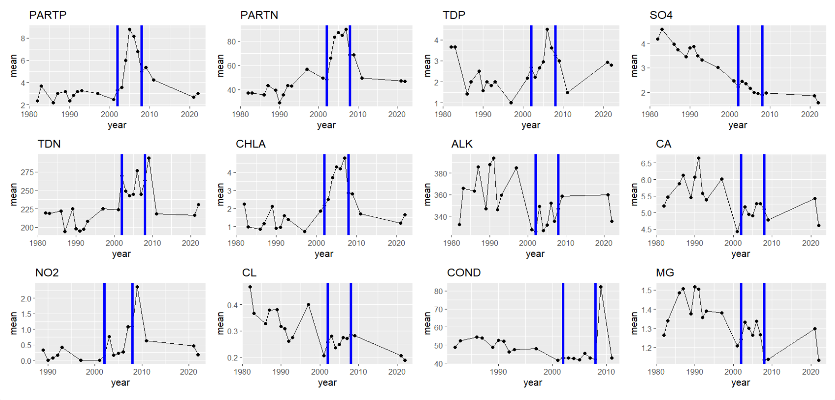
Water Chemistry Data Exploration
Average annual value of variables over time in epilimnion
Notes:
Elli We have time series data on many different water chemistry parameters measured from the epilimnion (top layer of lake)
Our data is time series data from before the experiment (pre 2003), during (2003-2007), and after (post 2007)
These plots show the average annual value of each variable over time
Today we’re going to focus on phosphorus, nitrogen, and chlorophyll A

Slide 5
Methodology
Explored the data and its distributions
Ran preliminary Anovas, GLMs and Linear Mixed Models for model selection
Ran 3 main statistical analyses
Linear Mixed Models
Permutation Tests for group means
ARIMA for Forecasting
Created Interpolated Graphs for each variable.
Notes:
Kumal

Slide 6
Permutation Analysis
Results | Treatment
2.00 | Before
0.50 | Before
5.20 | During
5.30 | During
4.80 | During
Results | Treatment
2.00 | Before
0.50 | During
5.20 | Before
5.30 | Before
4.80 | During
Notes:
Explanation of mean permutation

Slide 7
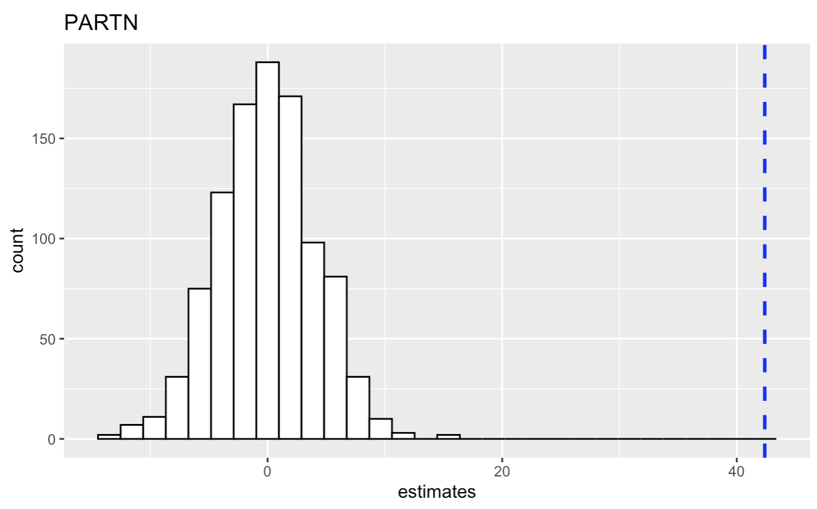
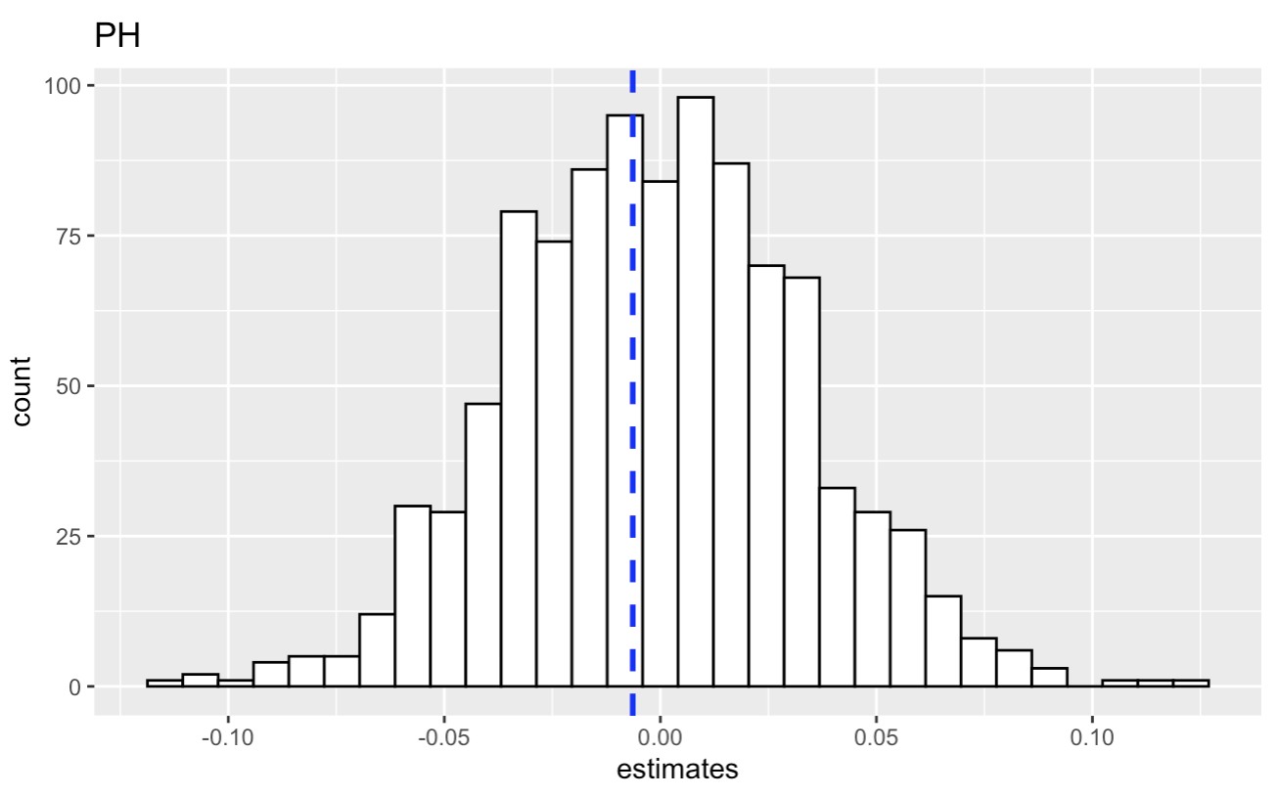
Permutation in Action
A Significant Result
A Not So Significant Result

Slide 8
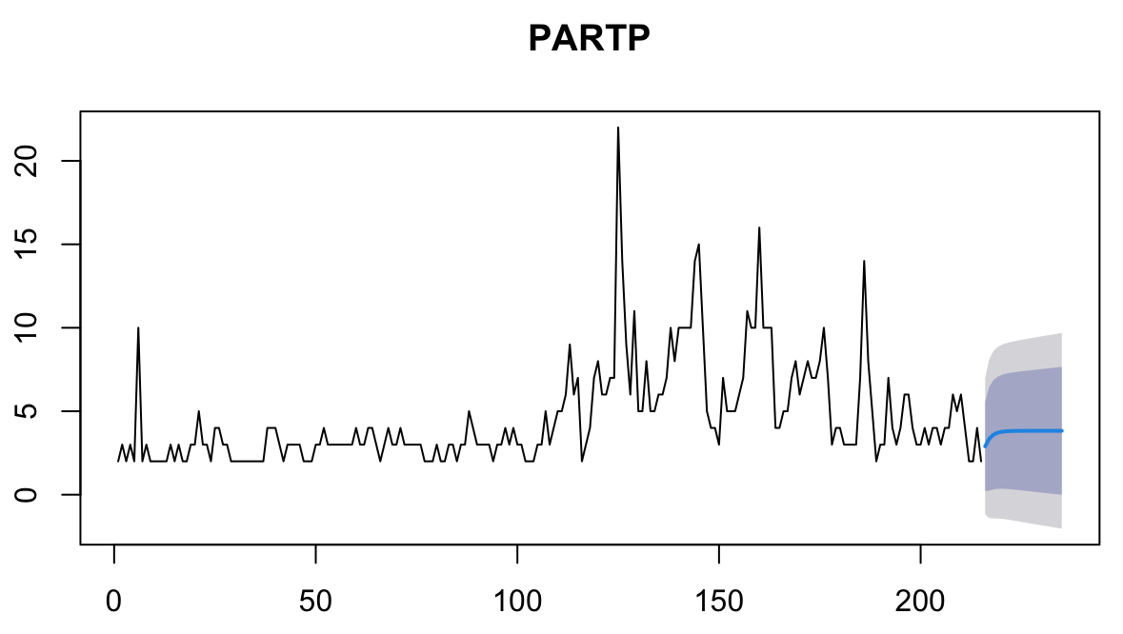
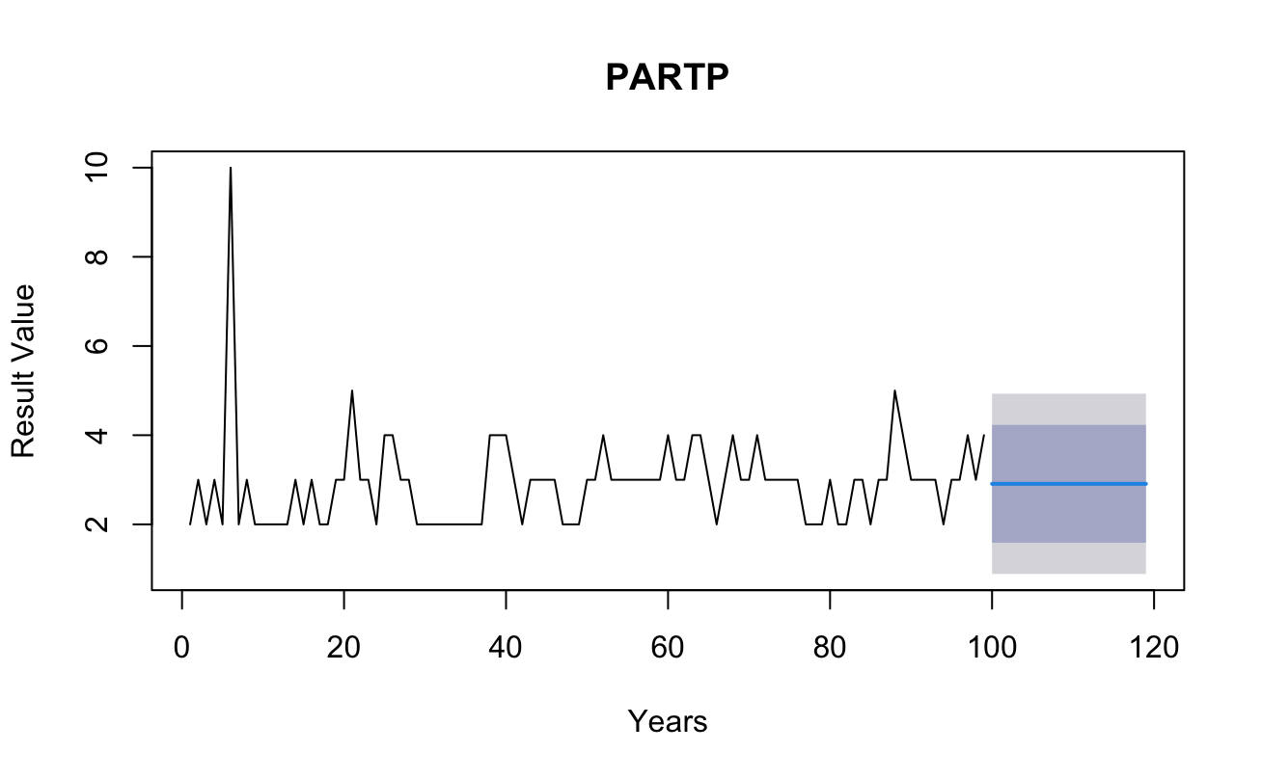
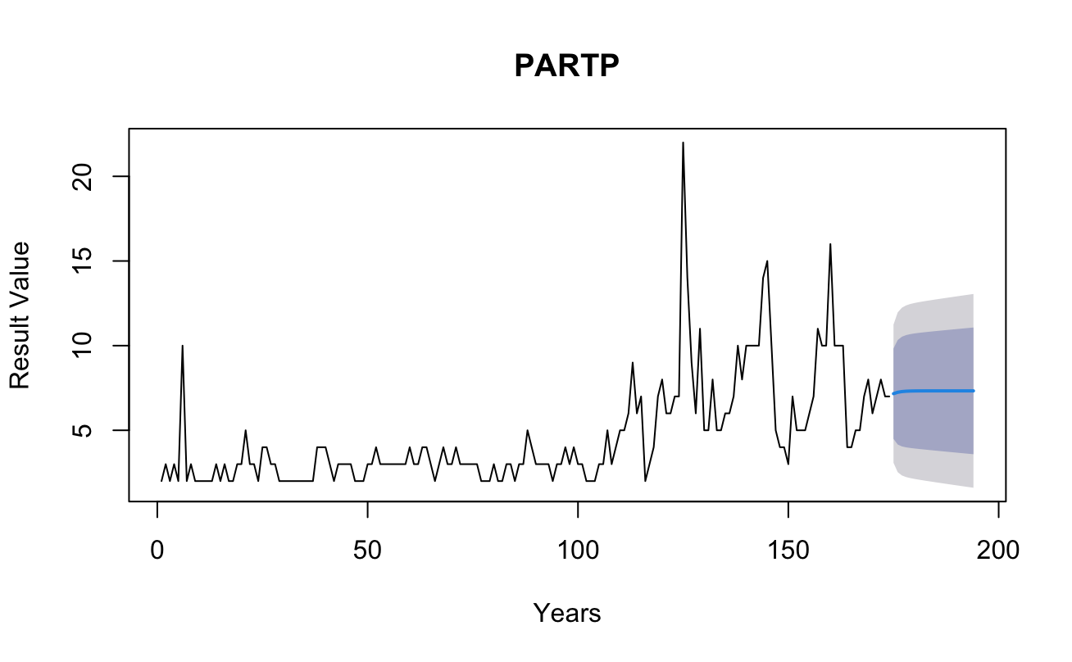
Forecasting With ARIMAs
Data given to model
Before
During
After
Data given to model
Before
During
After
Time steps
Time steps
Data given to model
Before
During
After
Time steps

Slide 9
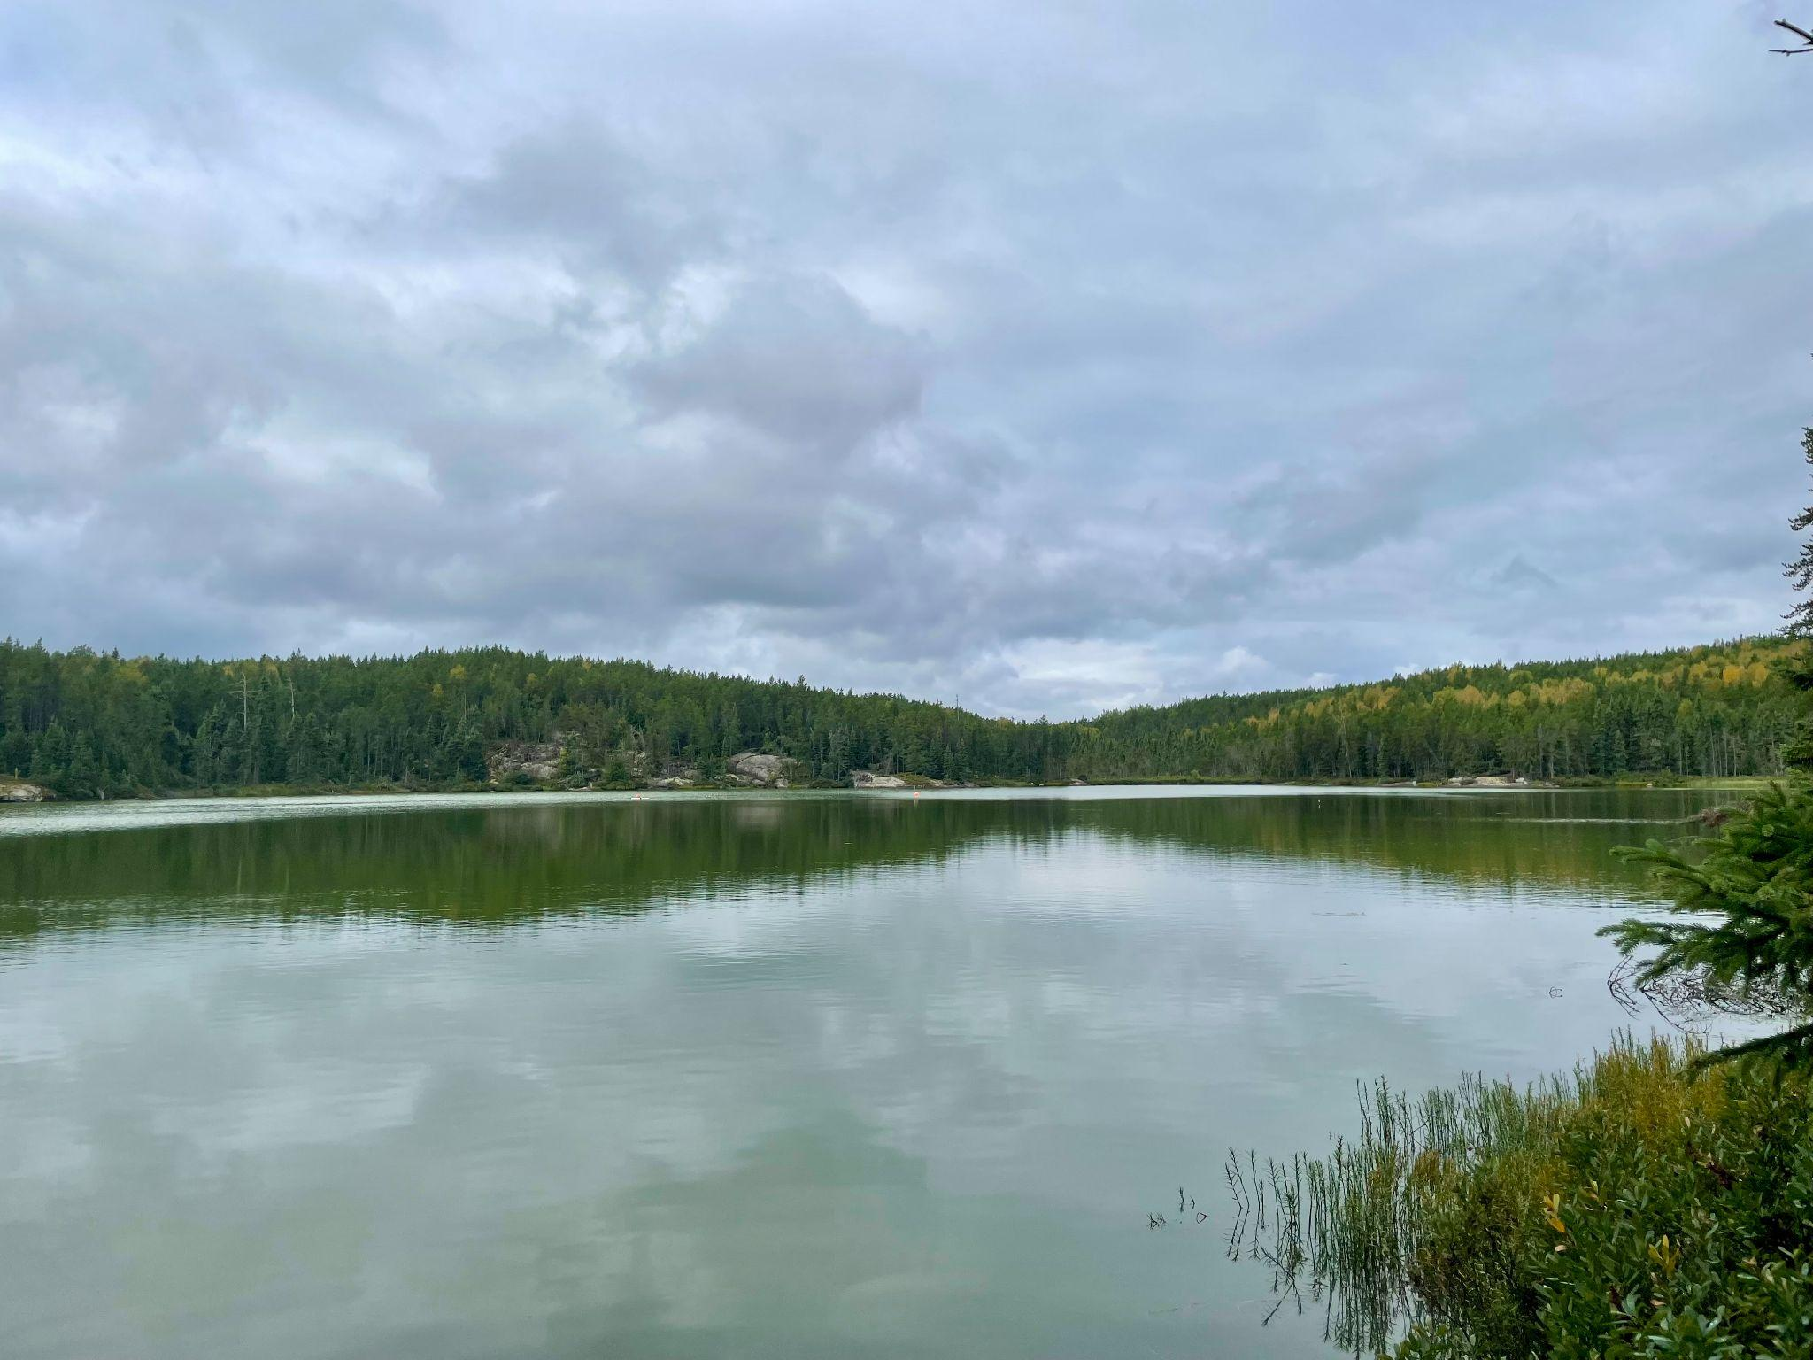
Rainbow Trout aquaculture in lakes will increase phosphorus and nitrogen concentrations in the epilimnion layer
Phosphorus generally occurs in small amounts in the natural environment
P and N are a key driver of productivity in freshwater ecosystems
Aquaculture causes increased nutrient input into the lake through fish feeding and extra fish waste being produced
Notes:
Karen

Slide 10
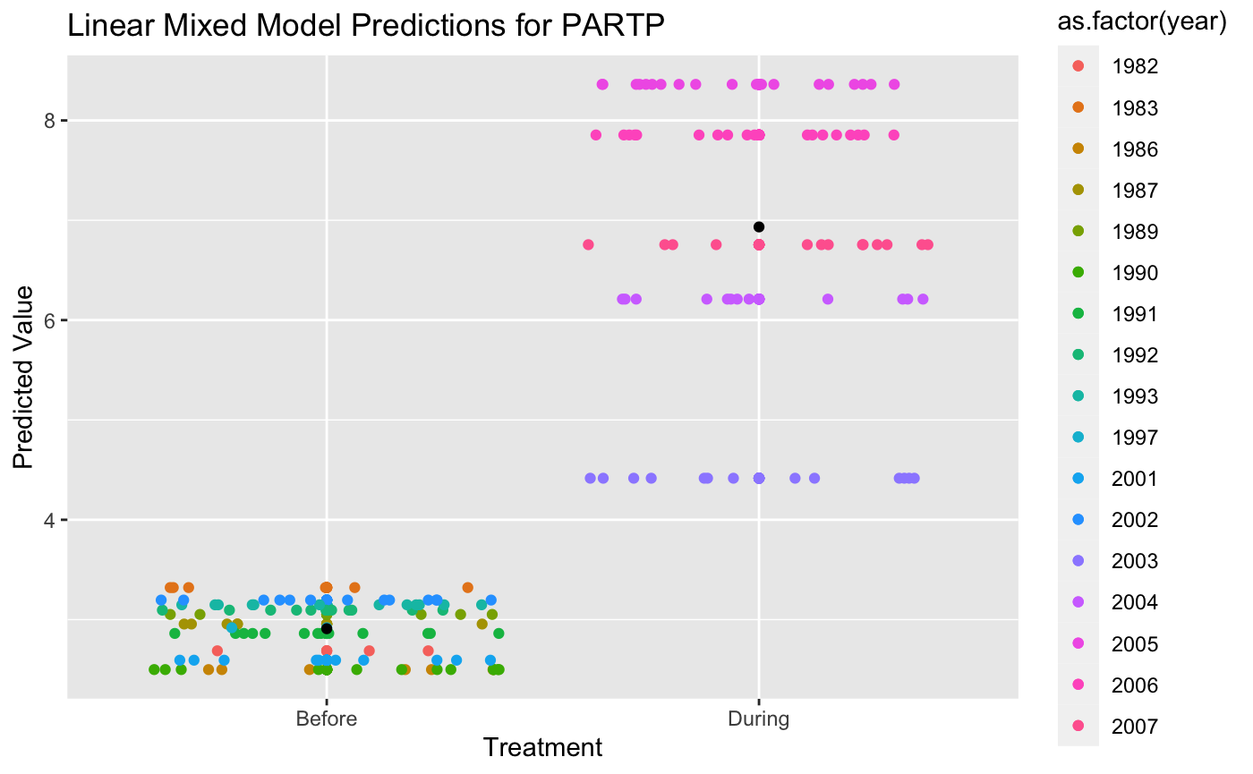
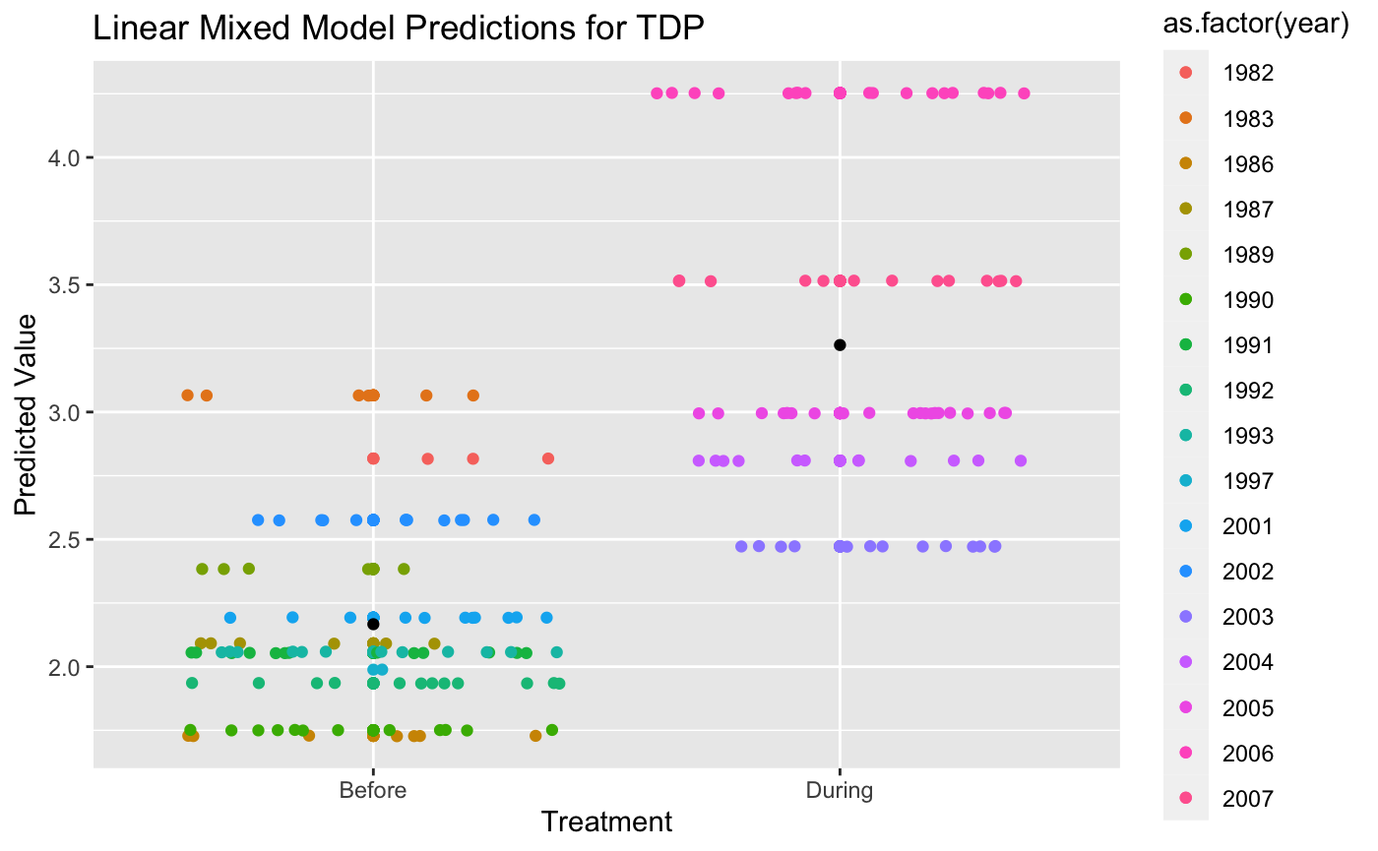
Phosphorus levels increased significantly after aquaculture
Effect size of treatment on PARTP: 3.81712ug/L
Characteristic | P Value
PARTP | 1.244521e-05
TDP | 1.694702e-02
Effect size of treatment on TDP: 0.98891ug/L
Notes:
Karen Visual rep of LMM
Graphing effect of treatment level (before or during) to see its effect on result_value
Shows sig difference between two treatments - p value is significant (aquaculture has significant effect on phosphorus levels)
Accounted for dependency in our time series data by plotting year as a random effect and you can see how each year affects the predicted result value
Black dot is the predicted mean derived from the LMM

Slide 11
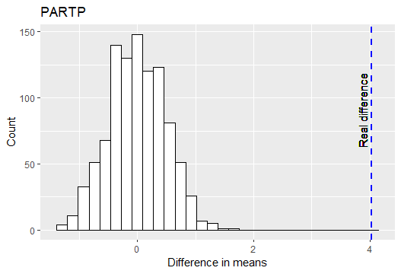
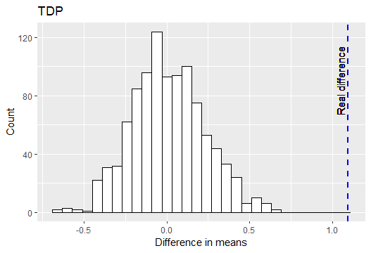
Phosphorus levels increased significantly after aquaculture
Real difference (PARTP): 4.0242
Real difference (TDP): 1.0965

Slide 12
ARIMA predicts phosphorus levels will change with aquaculture
Result value (ug/L)
Result value (ug/L)
Time steps
Time steps
Data given to model
Before
During
After
Data given to model
Before
During
After
Notes:
Maximum predicted range of P [] is greater when including during data

Slide 13
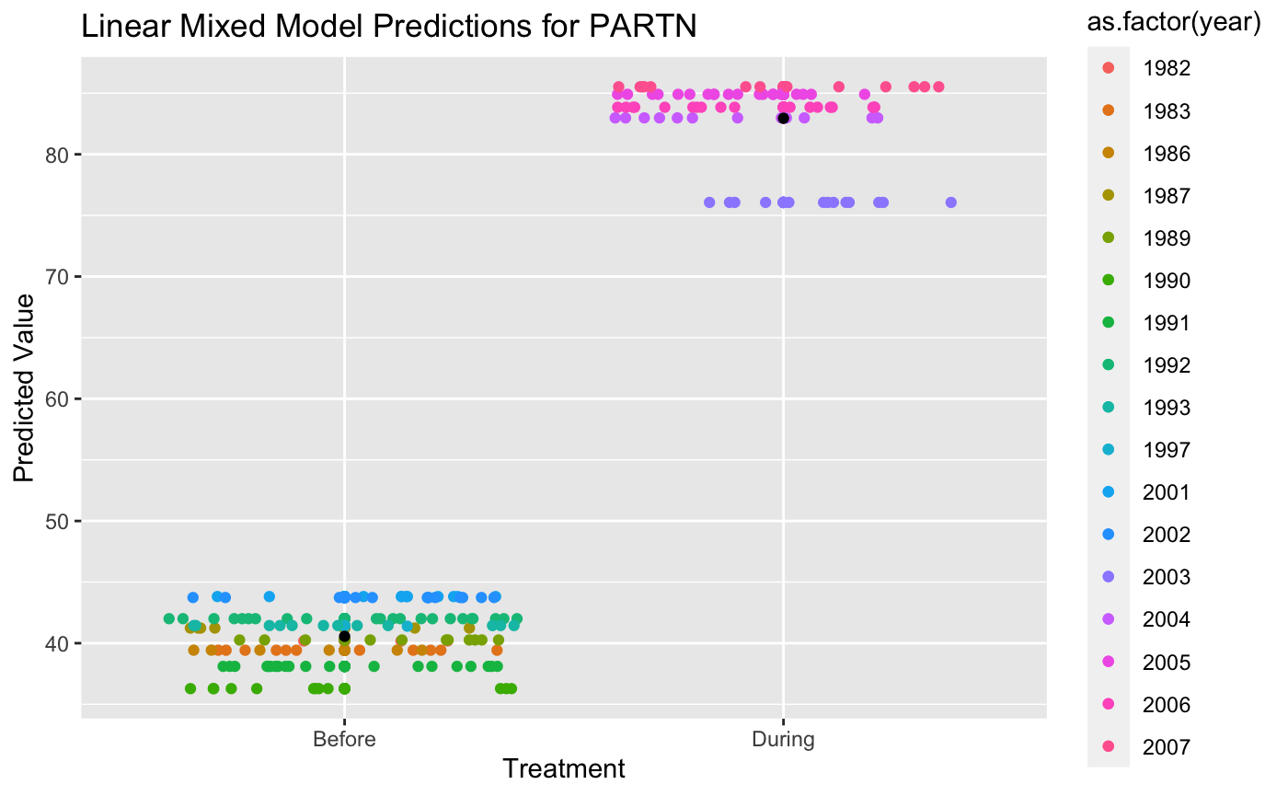
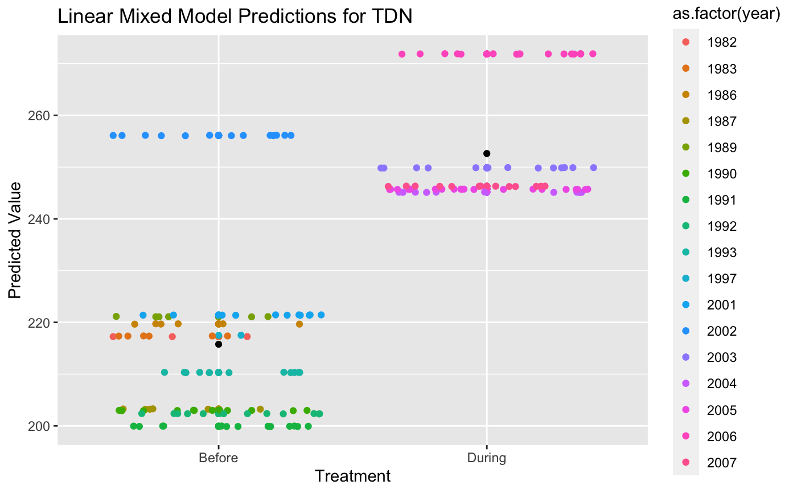
Nitrogen levels increased significantly with aquaculture
Effect size of treatment on PARTN: 42.0569ug/L
characteristic | P value
PARTN | 1.820811e-08
TDN | 2.859588e-03
Effect size of treatment on TDN: 36.0133ug/L
Notes:
Karen Compare and contrast to phosphorus
Random effect of year is not as variable as we saw in phosphorus

Slide 14
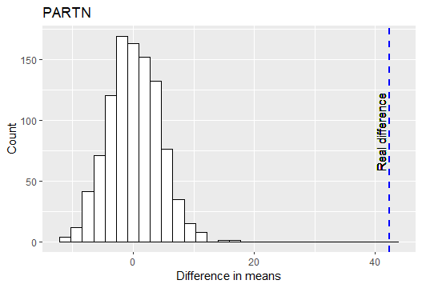
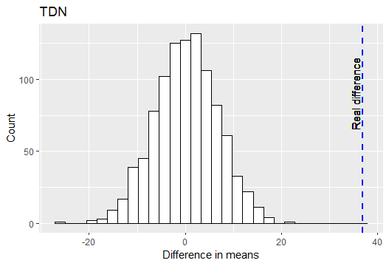
Nitrogen levels increased significantly with aquaculture
Real difference (PARTN): 42.384
Real difference (TDN): 36.8571

Slide 15
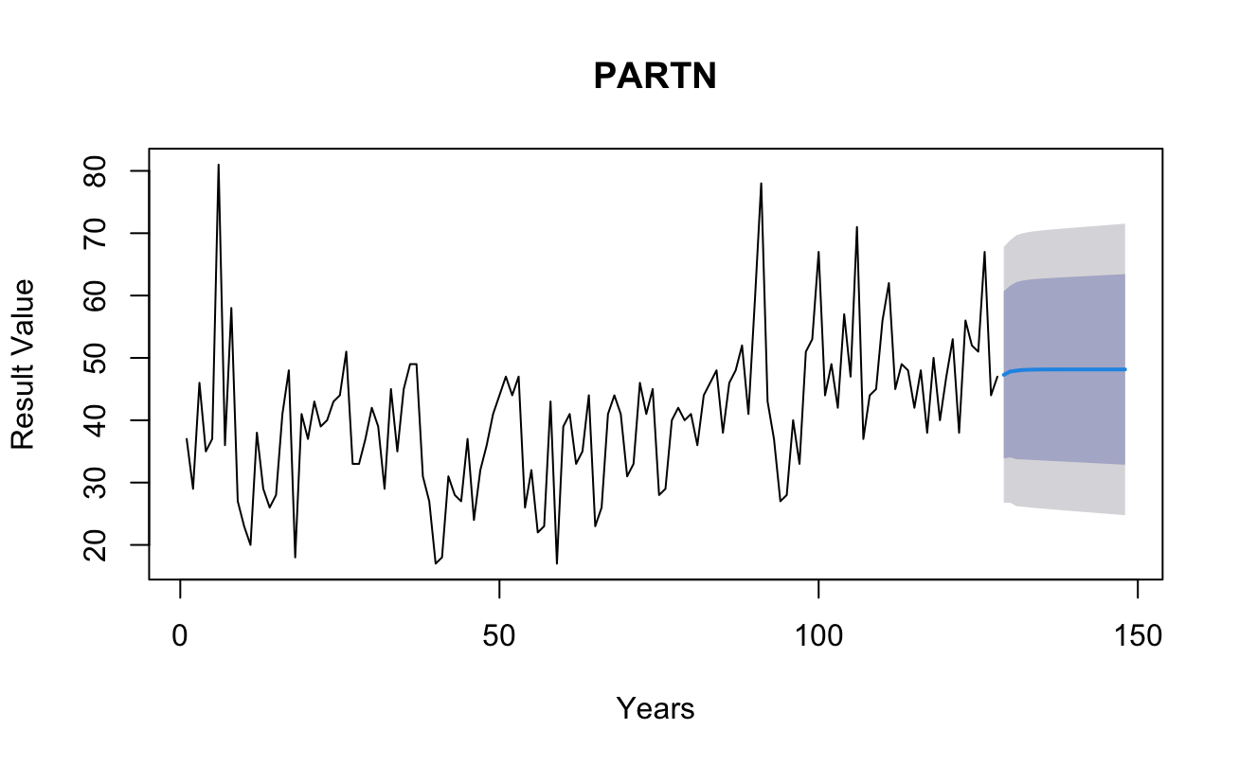
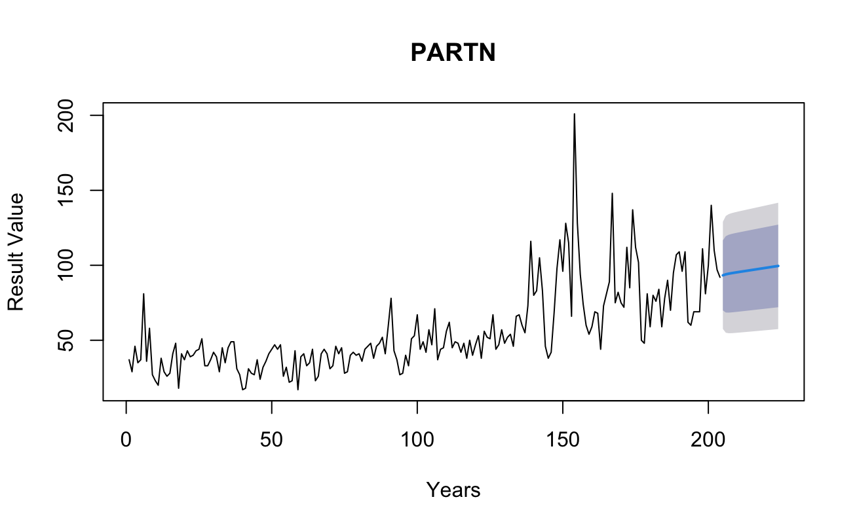
ARIMA predicts different trend if aquaculture continues
Result value (ug/L)
Result value (ug/L)
Time steps
Data given to model
Before
During
After
Data given to model
Before
During
After
Time steps

Slide 16
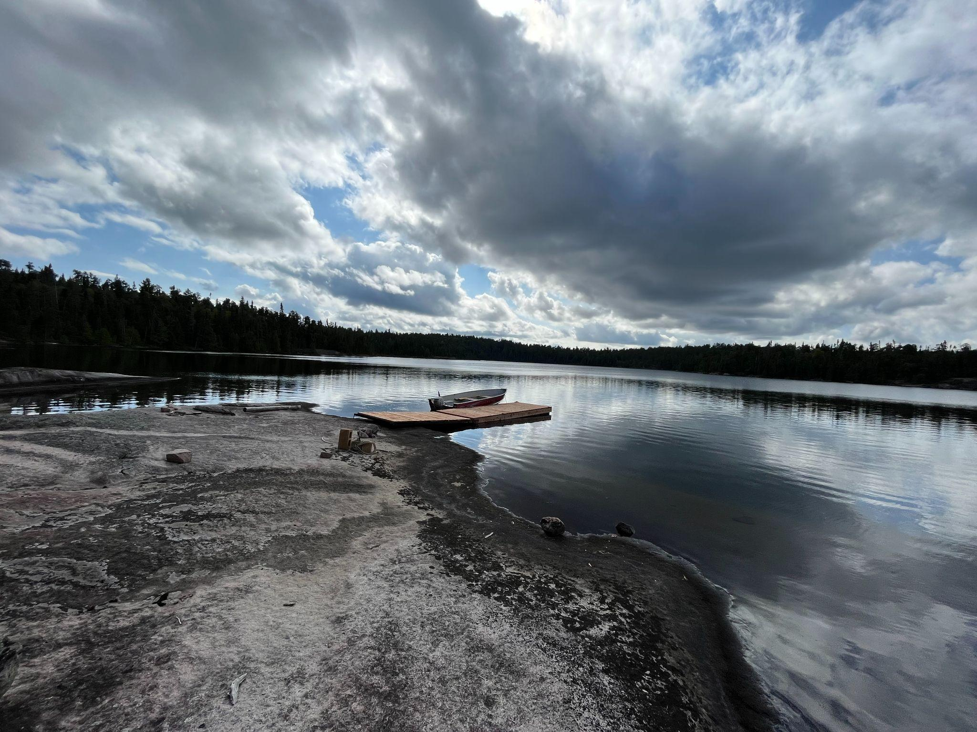
Rainbow Trout aquaculture in boreal shield lakes will increase chlorophyll a concentrations in the epilimnion layer
Chlorophyll a used as a measure of phytoplankton biomass present in the water and represents the primary productivity of the environment.
Previous ELA experiments suggest a consistent, high fertilization rate of P would create eutrophic conditions that would lead to dense phytoplankton blooms ².
Molot et al. (2021)
Notes:
Jaden

Slide 17
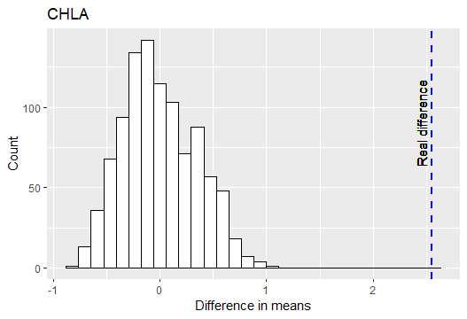
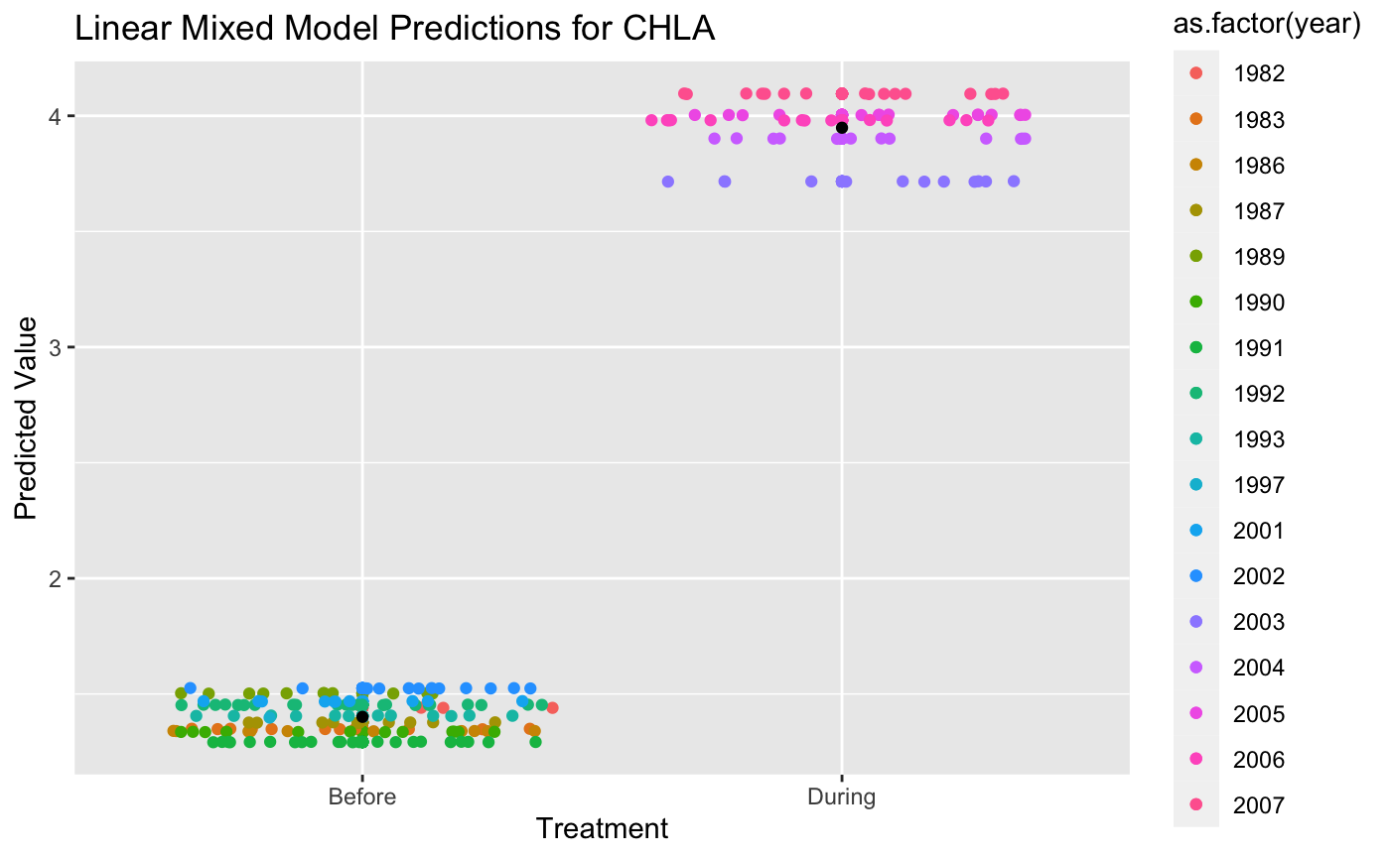
Chlorophyll a experiences significant increases with aquaculture
Permutation
Linear Mixed Model
Effect size of treatment on CHLA: 2.532380107ug/L
The difference in group means in our real data lies above the 95% confidence interval set by the null distribution of the permutation test.
characteristic | P value
CHLA | 1.137034e-07
Notes:
Permutation shows significant difference in group means between the two treatment groups. The linear mixed model shows the same, and the close clustering of the points indicates that there is very little variation between each year.

Slide 18
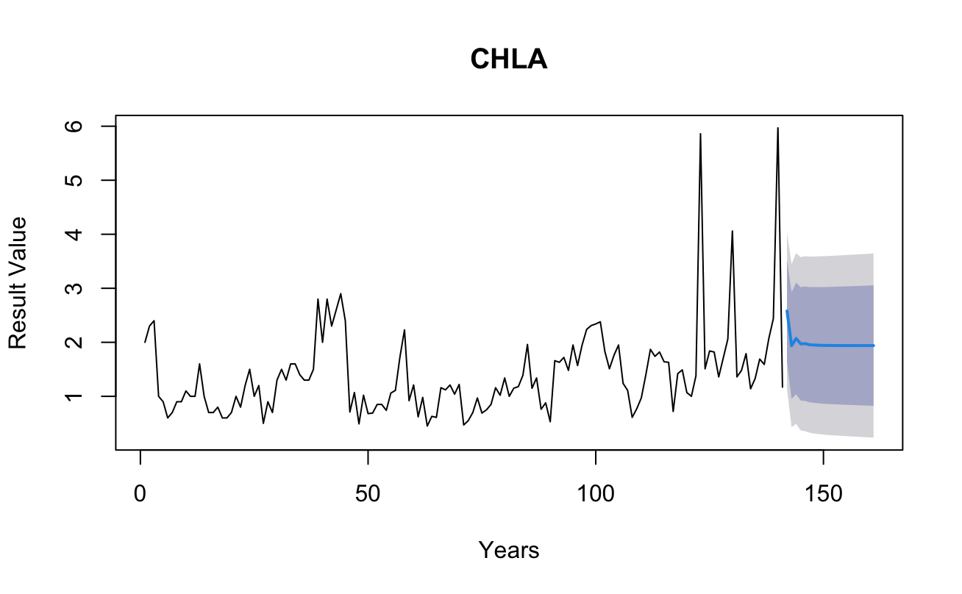
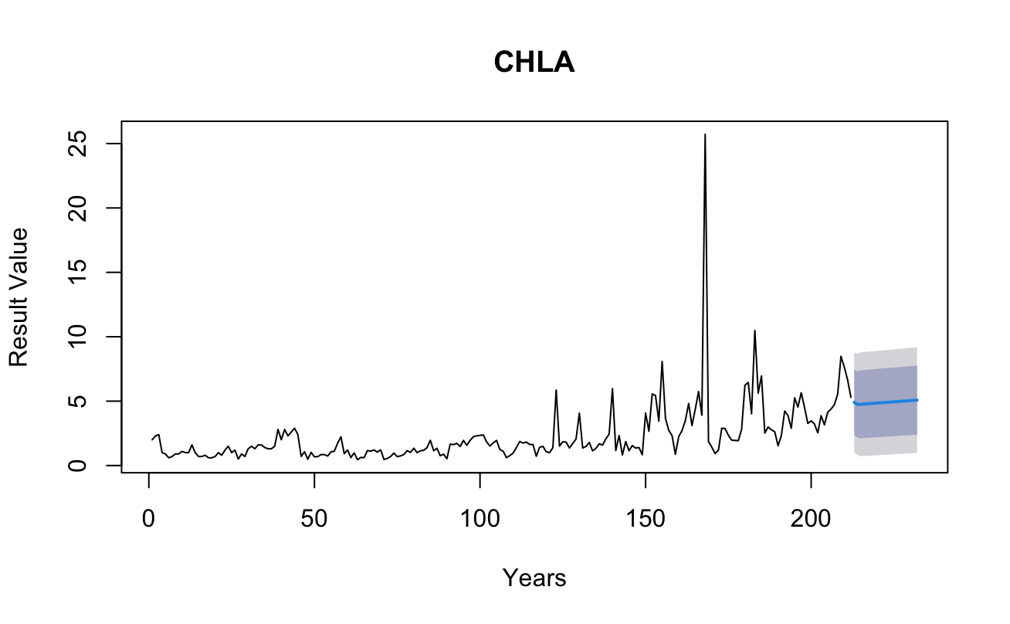
ARIMA forecasting shows predicted increases in Chlorophyll A
Time steps
Time steps
Data given to model
Before
During
After
Data given to model
Before
During
After
Notes:
The forecasting shows an increase in the range of variation of resultant values (dark grey area) between the before and the during treatments.

Slide 19

Phosphorus and nitrogen implications
Oligotrophic -> Eutrophic?
Cage rainbow trout aquaculture releases ~7.3kg of P into environment for every 1 tonne of fish produced ¹
Increased nutrient input can stimulate primary production eutrophication, changes in species community composition ²
Effects of nutrient addition not as large as the addition itself (lake was not eutrophic!)
Particulate phosphorus settled at a rate >6cm/s, meaning that it is unavailable to algae and bacteria in the epilimnion until thermal mixing occurs ^{1, 3}
Dissolved N levels in epilimnion lower than expected, likely due to sedimentation of solid waste and increased transformation of ammonia into nitrates and nitrites ^{1,4}
Azevedo et al. (2011)
Findlay et al. (2009)
Bristow et al. (2008)
McDonald et al. (1996)
Notes:
Mention how oxygen levels change during eutrophication
Lake remained oligotrophic throughout the aquaculture period and had higher hypolimnetic dissolved O [] compared to an epilimnion-fertilized lake (Bristow).

Slide 20

Ecosystem Effects of Aquaculture
Aquaculture waste introduced high levels of phosphorus into the lake.
The heavy P loading leads to an increase in nitrogen-fixing cyanobacteria, thus increasing N without anthropogenic input ¹.
Native species, minnows in particular, progressively shifted their diet towards the novel energy source from aquaculture ².
Molot et al (2021)
Kullman et al. (2009)
Notes:
Jaden

Slide 21

Ecosystem Effects of Aquaculture
High levels of nutrient pollution increases the risks of algae blooms, causing cyanotoxin poisoning, eutrophication, and turbidity ¹.
Much of the P from feces will settle into the substrate, unavailable to primary producers at sunlight zone until thermal mixing occurs ².
Sediment and waste from the farmed fish can fall to the lakebed and cause damage to benthic species ³.
Hecky et al. (2007)
Azevedo et al. (2011)
Kullman et al. (2007)

Slide 22
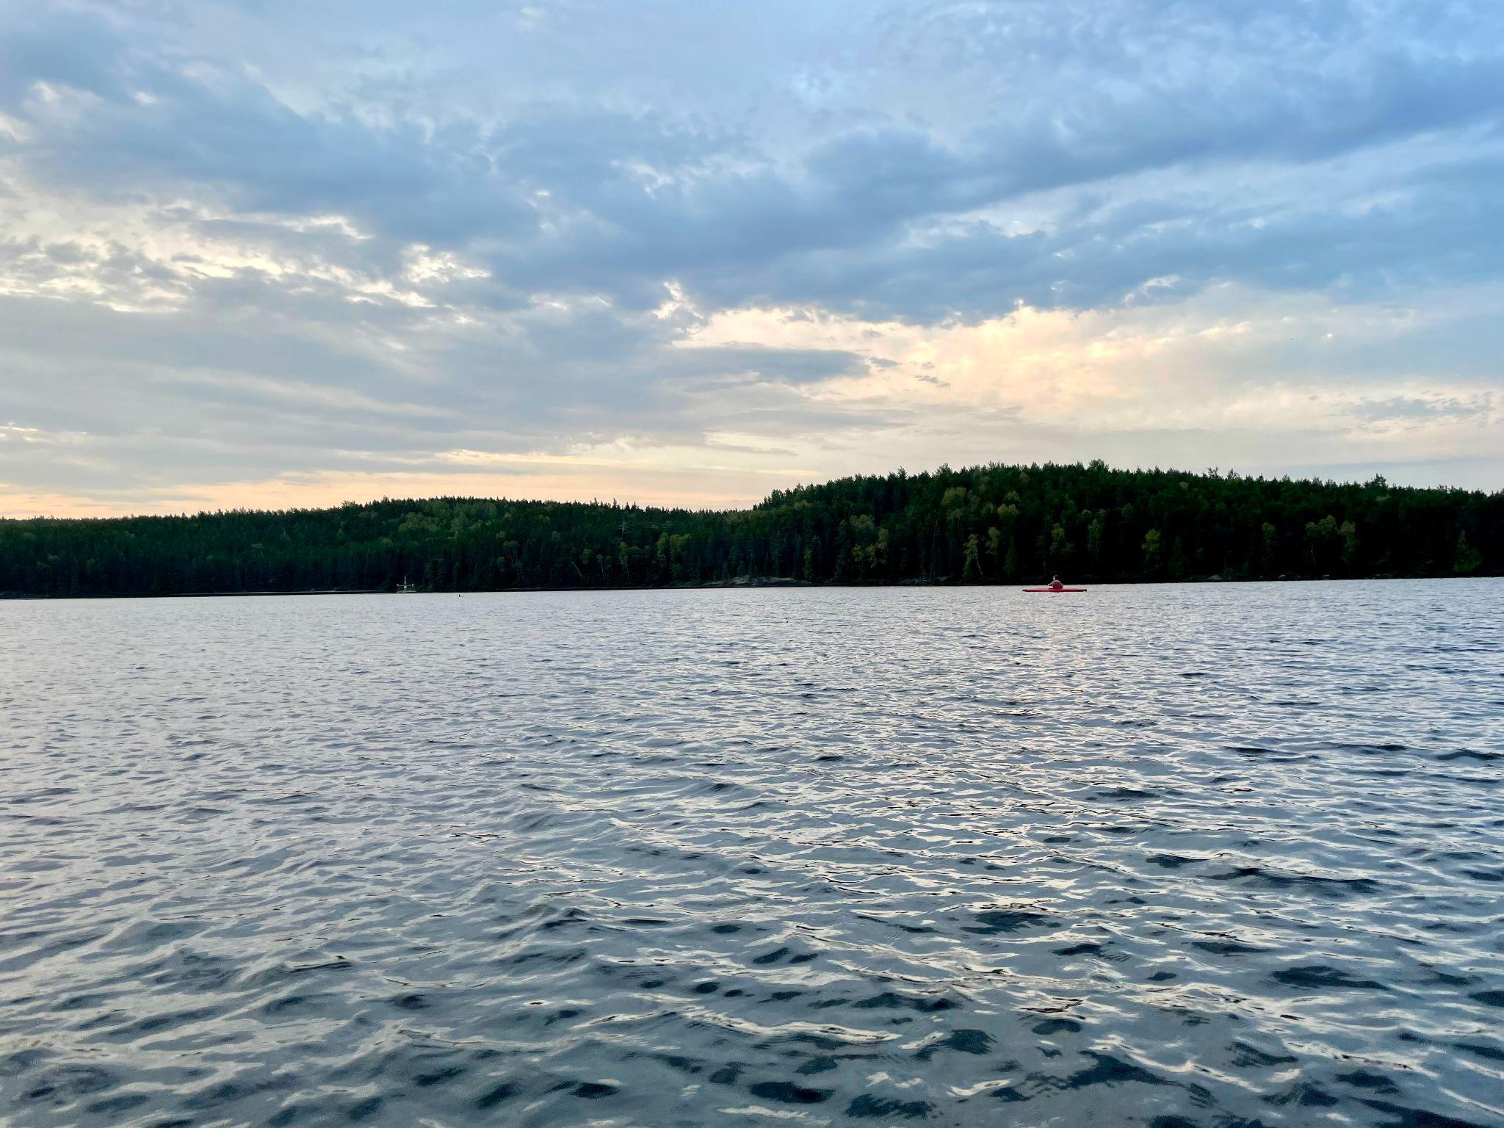
Conclusions
Statistically significant increase in phosphorus, nitrogen, and chlorophyll a
Lakes were not eutrophic:
Rapid sedimentation of phosphorus
Only considering epilimnetic water chemistry
Ecosystem biology effects not reflected
Lakes are complex; water chemistry alone cannot predict or tell the whole story of anthropogenic influences

Slide 23
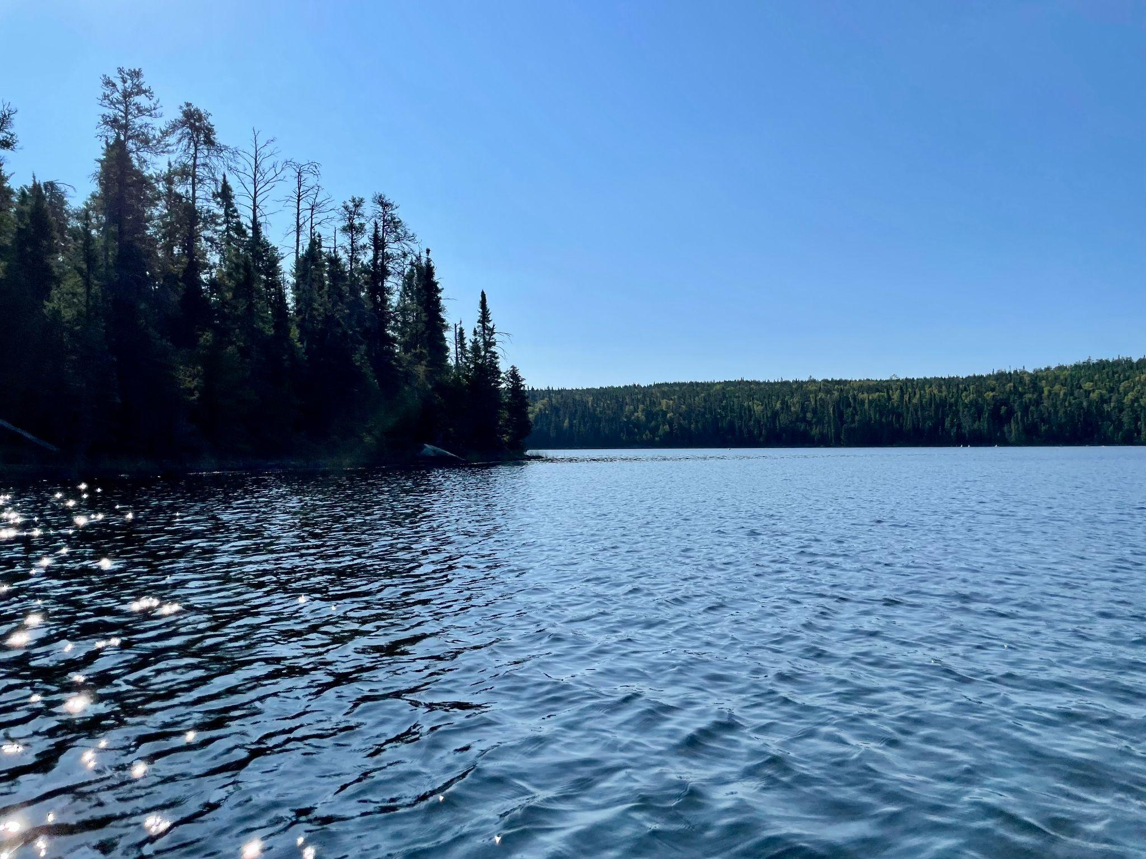
Works Cited
Azevedo, P. A., Podemski, C. L., Hesslein, R. H., Kasian, S. E. M., Findlay, D. L., & Bureau, D. P. (2011). Estimation of waste outputs by a rainbow trout cage farm using a nutritional approach and monitoring of lake water quality. Aquaculture, 311(1–4), 175–186. https://doi.org/10.1016/j.aquaculture.2010.12.001
Bristow, C. E., Morin, A., Hesslein, R. H., & Podemski, C. L. (2008). Phosphorus budget and productivity of an experimental lake during the initial three years of cage aquaculture. Canadian Journal of Fisheries and Aquatic Sciences, 65(11), 2485–2495. https://doi.org/10.1139/f08-155
Costello, C., Cao, L., Gelcich, S., Cisneros-Mata, M. Á., Free, C. M., Froehlich, H. E., Golden, C. D., Ishimura, G., Maier, J., Macadam-Somer, I., Mangin, T., Melnychuk, M. C., Miyahara, M., de Moor, C. L., Naylor, R., Nøstbakken, L., Ojea, E., O’Reilly, E., Parma, A. M., … Lubchenco, J. (2020). The future of food from the sea. Nature, 588(7836), Article 7836. https://doi.org/10.1038/s41586-020-2616-y
Hecky, R. E., Campbell, P., & Hendzel, L. L. (1993). The stoichiometry of carbon, nitrogen, and phosphorus in particulate matter of lakes and Oceans. Limnology and Oceanography, 38(4), 709–724. https://doi.org/10.4319/lo.1993.38.4.0709
Kullman, M. A., Kidd, K. A., Podemski, C. L., Paterson, M. J., & Blanchfield, P. J. (2009). Assimilation of freshwater salmonid aquaculture waste by native aquatic biotathis paper is part of the series “Forty years of aquatic research at the experimental lakes area”. Canadian Journal of Fisheries and Aquatic Sciences, 66(11), 1965–1975. https://doi.org/10.1139/f09-128
Kullman, M. A., Podemski, C. L., & Kidd, K. A. (2007). A sediment bioassay to assess the effects of aquaculture waste on growth, reproduction, and survival of Sphaerium simile (say) (Bivalvia: Sphaeriidae). Aquaculture, 266(1–4), 144–152. https://doi.org/10.1016/j.aquaculture.2006.12.048
McDonald, M. E., Tikkanen, C. A., Axler, R. P., Larsen, C. P., & Host, G. (1996). Fish simulation culture model (FIS-C): A bioenergetics based model for aquacultural wasteload application. Aquacultural Engineering, 15(4), 243–259. https://doi.org/10.1016/0144-8609(96)00260-9
Molot, L. A., Higgins, S. N., Schiff, S. L., Venkiteswaran, J. J., Paterson, M. J., & Baulch, H. M. (2021). Phosphorus-only fertilization rapidly initiates large nitrogen-fixing cyanobacteria blooms in two oligotrophic lakes. Environmental Research Letters, 16(6), 064078. https://doi.org/10.1088/1748-9326/ac0564
Findlay, D. L., Podemski, C. L., & Kasian, S. E. M. (2009). Aquaculture impacts on the algal and bacterial communities in a small boreal forest lakeThis paper is part of the series “Forty Years of Aquatic Research at the Experimental Lakes Area”. Canadian Journal of Fisheries and Aquatic Sciences, 66(11), 1936–1948. https://doi.org/10.1139/f09-121

Slide 24
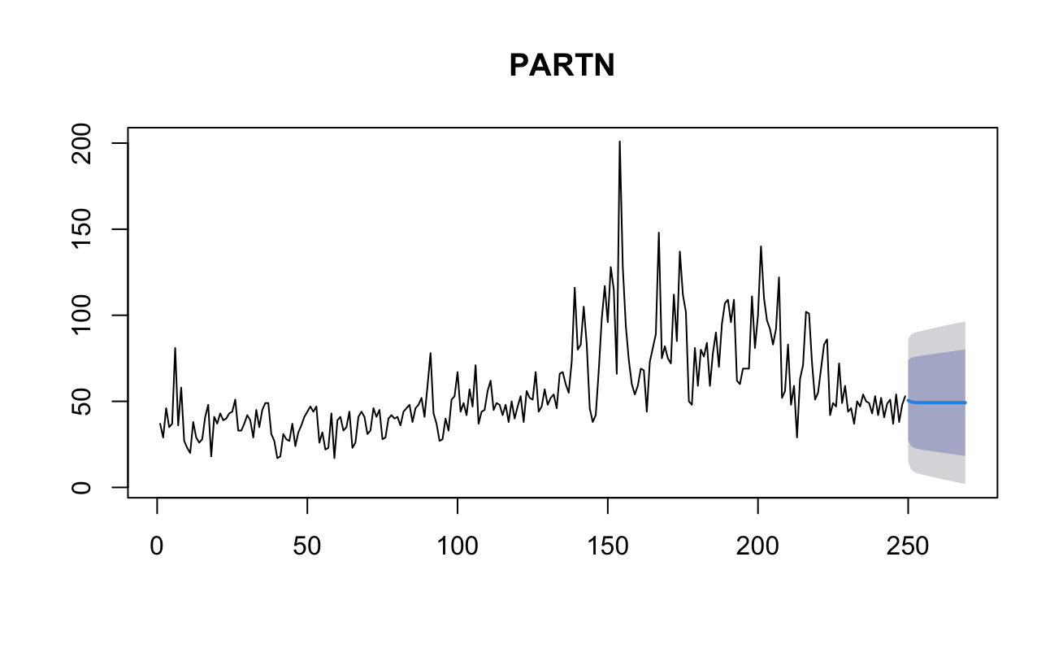
ARIMA predicts different trend if aquaculture continues
Time steps
Time steps
Data given to model
Before
During
After
Data given to model
Before
During
After

